Slide 1
ADULT, COMMUNITY AND FURTHER EDUCATION BOARD
EXPRESSION OF INTEREST PROCESS
FOR 2021 ACFE BOARD TRAINING DELIVERY
September 2020

Slide 2
ACKNOWLEDGEMENT OF COUNTRY
We acknowledge the Traditional Owners of the land on which we are meeting. We pay our respects to their Elders, past, present and emerging and the Aboriginal Elders of other communities who may be here today.
You can use the interactive map in this link to locate and acknowledge the Formally Recognised Traditional Owners of the land you are on:
https://achris.vic.gov.au/weave/wca.html

Slide 3
COVID-19 IMPACTS
First of all, the ACFE Board and the Department acknowledge the impacts of COVID-19 on the delivery of ACFE funded programs by Learn Locals.
Thank you for your continued efforts to maintain training delivery and engagement in 2020, as we look forward to 2021.
What does this mean for your 2021 pre-accredited training delivery allocation?
The ACFE Board has approved a 2021 pre-accredited allocation for each provider, up to a maximum of their total 2020 allocation by ACFE regional area.
Providers may request to reduce their allocation.

Slide 4
WHAT WILL BE COVERED IN TODAY’S SESSION
This information session will cover the Expression of Interest (EOI) process for the following ACFE funded programs for 2021.
1
2
3
4
5
Purpose of Pre-accredited Training Delivery
Pre-accredited Training Delivery EOI Process and Timeline
LEAP EOI Process and Timelines
Next
Steps and Further Opportunities
Questions and Feedback
* There will be a separate information session on the details of Skills for Work and Study pilot programs, on Monday 28 September.

Slide 5
PRE-ACCREDITED TRAINING – PURPOSE AND ROLES

Slide 6






PRE-ACCREDITED TRAINING DELIVERY
The primary purpose of pre-accredited education and training is to provide opportunities for adult learners in Victoria to gain the educational capacity and core skills they need for study, work and life.
Pre-accredited education and training addresses the particular needs of adults who have experienced barriers to education in the past.
Pre-accredited training programs focus on creating pathways for learners to further education and training or a pathway to employment.
Programs are designed to be flexible, meet learners’ needs and support them to return to study, improve their literacy and numeracy skills, their qualification pathways and broaden their employment options.

Slide 7
2021 PRE-ACCREDITED TRAINING
New ACFE Board Strategy 2020-25
It is expected that pre-accredited programs will reflect the Board’s strategic priorities outlined in the ACFE Board Strategy 2020-25.
The Strategy is a primary means to implement the Ministerial Statement on the Future of Adult Community Education in Victoria 2020-25.
The ACFE Board has identified people who have experienced educational disadvantage as a priority in the design and delivery of pre-accredited programs.

Slide 8
PRE-ACCREDITED TRAINING – WHAT’S NEW
Pre-accredited alignment to ACFE Board Strategy 2020-25
In 2021, contracted providers are expected to deliver pre-accredited programs aligned to one or more of the four roles outlined in the ACFE Board Strategy 2020-25:
Engage and participate in further education and training - Building confidence and skills for participation in education and training
Achieve success in further education and training - Supporting successful attainment in accredited training
Engage and participate in work - Building confidence and skills for participation in work
Achieve success in work - Upskilling and reskilling vulnerable worker.
Notes:
.

Slide 9

2021 PRE-ACCREDITED TRAINING ALLOCATIONS
In recognition of the impact of COVID-19, the ACFE Board has approved a 2021 pre-accredited allocation for each provider, up to a maximum of their 2020 allocation by ACFE regional area.
Providers may request to reduce their allocation.
However, you cannot move allocations between ACFE regional areas.
Should hours be unallocated, these will be redistributed via a separate process, according to priorities and criteria set by the ACFE Board.

Slide 10

ACFE BOARD AND REGIONAL COUNCIL ROLES
ACFE Board
The role of the ACFE Board is to plan and promote adult learning, allocate resources, develop policies, and advise the Minister for Training and Skills and Higher Education on matters related to adult education in Victoria.
Through the Board, the Victorian Government provides funding to Learn Local providers, AMES Australia and the CAE, to deliver education and training programs to a broad range of Victorians over compulsory school-leaving age, with a special focus on people who have had limited prior access to education.
Regional Council
Using their different expertise and local knowledge about adult education, Regional Councils advise the ACFE Board on the needs of adult education across their region and contribute to state-wide planning and policy development.

Slide 11
PRE-ACCREDITED TRAINING EXPRESSION OF INTEREST PROCESS AND TIMELINE

Slide 12
PROVIDER ELIGIBILITY TO DELIVER
PRE-ACCREDITED TRAINING
ACFEB Registration
AMES Australia and CAE are covered under the Education and Training Reform Act 2006.
Trained Staff to use your SMS and SVTS
Current Business and Governance Status (BGS) or
Have a current Skills First contract to deliver government subsidised accredited training.
An AVETMISS-compliant Student Management System
Delivery Plan and A-frames aligned with the ACFEB Strategy 2020-25
SAMS2 Registration
To be eligible to receive funding for government subsidised pre-accredited training, providers must have:

Slide 13
Who can enrol in subsidised pre-accredited training?
 |  | ELIGIBILE | NOT ELIGIBLE
LEARNER eligibility CRITERIA | Australian Citizen
 | Holder of an Australian permanent visa
 | New Zealand citizen
 | Principle place of residence NOT in Victoria |  | ✗
 | A prisoner held at a prison, within the meaning of the Corrections Act 1986 |  | ✗
 | Detained under the Mental Health Act 1986; or the Crimes (Mental Impairment and Unfitness to be Tried) Act 1997 or the Sentencing Act 1991 at the Thomas Embling Hospital |  | ✗
 | Detained (other than on weekend detention) under the Children, Youth and Families Act 2005 or the Sentencing Act 1991 or who is held on remand in the Malmsbury Juvenile Justice Centre or Parkville Youth Residential Centre. |  | ✗
 | Enrolled at school. |  | ✗
 |  | ELIGIBILE | NOT ELIGIBLE
ASYLUM SEEKERS | Asylum seekers in specified visa categories, referred by Jobs Victoria Employment Network providers to pre-accredited pre-employment programs.
 | Citizenship requirements apply for accessing all other ACFE Board pre-accredited training programs. There is currently no exemption for asylum seekers to participate in ACFE Board subsidised programs, other than Jobs Victoria referred clients (above). Asylum seekers in specified visa categories are separately eligible for specific Department-funded asylum seeker VET programs. |  | ✗

Slide 14
ACFE BOARD ALLOCATION TO ACFE REGIONAL AREAS
The contracting of pre-accredited student contact hours is conducted through a formal Government procurement and purchasing process.
The ACFE Board allocates resources for student contact hours to the 8 ACFE regional areas under a fixed annual budget.
The distribution of resources to the 8 ACFE regional areas is determined by a demographically driven formula based on the 2016 Census data, moderated by demonstrated demand and provider capacity to deliver.
The formula is calculated on the ACFE regional area’s share of the Victorian working age population (people aged 15–69 who are not attending school) with a weighting for the proportion of the ACFE regional area population who are educationally disadvantaged.
Within the context of a fixed budget, equitable distribution of Government funds, taking into account statewide needs and informed by Regional Council advice, is a critical consideration.

Slide 15
PRE-ACCREDITED TRAINING DELIVERY FUNDING PROCESS
Notes:
.

Slide 16

PROCUREMENT BY EXPRESSION OF INTEREST
Every EoI must meet the pre-accredited training delivery guidelines which require a proposed Delivery Plan with A-frames that meet ACFE Board priorities and quality standards for pre-accredited training delivery.
Your proposed Delivery Plan will be considered for its alignment with the ACFE Board Strategy 2020-25, the intent, content and quality of proposed courses and the demand for training in each Local Government Area.
Registered Learn Local providers with a current Business and Governance Status or a current Skills First contract, and AMES Australia and CAE, are invited to submit an Expression of Interest (EoI) for their proposed pre-accredited training delivery by LGA.

Slide 17
HOW TO APPLY FOR PRE-ACCREDITED TRAINING DELIVERY FUNDING
EOI OPENED 14 SEPTEMBER AND CLOSES ON 14 OCTOBER 2020
Download and read the 2021 ACFE Board Pre-accredited Training Delivery Guidelines
Download and complete the 2021 Pre-accredited Delivery Plan template
Prepare the 2021 Pre-accredited Delivery Plan by LGA. Please ensure you list your modules in order of priority, up to a maximum of your 2020 student contact hour allocation.
Prepare Course Plans for existing pre-accredited modules. Prepare a full A-frame including Course Plans and Session Plans for new or substantially amended pre-accredited modules.
Submit your EoI including Delivery Plans and A-frames by COB 14 October 2020 via email to: training.participation@education.vic.gov.au
1
2
3
4
5
Note: You must submit ONE email which includes all Delivery Plans and if applicable, A-frames for all programs you are applying for. You may need to zip the files. If you cannot fit all documents, please ensure that all Delivery Plans are in one email. Once submitted to the training participation inbox, you will receive an acknowledgement of submission. If you do not receive an acknowledgement within one week, please contact the Department.

Slide 18
PRE-ACCREDITED DELIVERY PLAN - EXAMPLE
The Delivery Plan template is a Microsoft Excel spreadsheet with a tab for instructions, and a tab for the Pre-accredited Delivery Plan.
What’s new!
ACFE Program Categories
Language (LNG suggested code prefix)
Literacy and Numeracy (ALN)
Employability (EMP)
Vocational (VOC)
Digital Literacy (DIG)
PRE-ACCREDITED DELIVERY PLAN 2021
Organisation Details |  |  | Summary - ACFE Program Categories (data automatically populates) |  |  |  |  |  |  |  |  | Office use only - to be completed by DET staff
Region | South Western Victoria |  | ACFE category | Planned 2021 (SCH) | % of total 2021 planned delivery |  | Mode of Delivery | Planned 2021 (SCH) | % of total 2021 planned delivery |  |  | LGA of Delivery | Total Student Contact Hours (SCH) | Total payment
Date Submitted |  |  | Language | 0 | 0% |  | Face to face | 900 | 100%
Provider Name |  |  | Literacy and Numeracy | 0 | 0% |  | Online | 0 | 0% |  |  |  |  | $0
TOID |  |  | Employability | 900 | 100% |  | Blended | 0 | 0% |  |  |  |  | $0
RTO status |  |  | Vocational | 0 | 0% |  | Total | 900 | 100% |  |  |  |  | $0
Contact Person |  |  | Digital Literacy | 0 | 0% |  |  |  |  |  |  |  |  | $0
Contact phone |  |  | Total | 900 | 100% |  |  |  |  |  |  |  |  | $0
Contact e-mail |  |  |  |  |  |  |  |  |  |  |  | Total Allocation | 0 | $0
DP Version No.
 |  |  |  |  |  |  |  |  |  |  |  | Grand Total SCH | $
Please refer to the INSTRUCTIONS TAB if you are unsure how to complete this template Please itemise each individual pre-accredited course - one row per course |  |  |  |  |  |  |  |  |  |  |  | $9.10 per SCH | 900 | $ 8,190.00
LGA of Delivery | New/Existing Course | Course Plan Overview / A-Frame | Has this A-frame been moderated | Local Code | Local course name | ACFE Program Categories | Primary Mode of delivery | Delivery site and partnerships | Learning Outcome including pathways | Anticipated Term/s of Delivery | Program Scheduled Hours (minimum 20 Hours) | Total No. of Students | Total Student Contact Hours (SCH) | Total payment
Brimbank City Council | Yes (new program) | Full A-Frame | Yes | 203STEPSTOEMP | Three Steps to Employment | Employability | Face to face | Eg: industry, school, community library, Neighbourhood House, TAFE | Learners will be able to articulate their employment goals and review their capabilities and gaps to achieve these. Learners will also become familiar with the Australian job search process and will experience Australian interview process. Pathways to further non accredited and or accredited learning. | 1, 2, 3, 4 | 30 | 30 | 900 | $8,190
 |  |  |  |  |  |  |  |  |  |  |  |  | 0 | $0
 |  |  |  |  |  |  |  |  |  |  |  |  | 0 | $0
 |  |  |  |  |  |  |  |  |  |  |  |  | 0 | $0
 |  |  |  |  |  |  |  |  |  |  |  |  | 0 | $0
 |  |  |  |  |  |  |  |  |  |  |  |  | 0 | $0
 |  |  |  |  |  |  |  |  |  |  |  |  | 0 | $0
 |  |  |  |  |  |  |  |  |  |  |  |  | 0 | $0
 |  |  |  |  |  |  |  |  |  |  |  |  | 0 | $0
 |  |  |  |  |  |  |  |  |  |  |  |  | 0 | $0
 |  |  |  |  |  |  |  |  |  |  |  |  | 0 | $0
 |  |  |  |  |  |  |  |  |  |  |  |  | 900 | 8,190
Modes of Delivery
Face to Face
Online
Blended
Delivery Site and Partnerships
Eg:
Industry, school, community library, Neighbourhood House, TAFE

Slide 19

THE PRE-ACCREDITED QUALITY FRAMEWORK
All programs on your Delivery Plan must meet the requirements of the Pre-accredited Quality Framework (PQF).
The PQF is a system of interrelated processes that ensure quality and continuous improvement in the cycle of planning, developing, implementing and reviewing pre- accredited courses.
The PQF supports teachers and managers to plan, develop, teach and review pre-accredited courses.
Key components of the PQF
A-frame
Pre-accredited course planning resource
Evaluation
Includes the processes and documentation for moderation and verification

Slide 20
DELIVERY PLAN ASSESSMENT CRITERIA
EoIs will be subject to the following assessment criteria:
Alignment to the ACFE Board Strategy 2020-25
quality of Course Plans and Session Plans
clear evidence that the proposed course aims to lead to further education, training or employment
evidence that the proposed course is aligned to one or more of the roles specified in the ACFE Board Strategy 2020-25
the course is targeted at the needs of educationally disadvantaged adults
evidence of course evaluation/moderation
relevance of the proposed course to the Local Government Area (LGA) including local community needs and regional area priorities
the provider’s history of delivery to contract
the provider’s capacity to meet delivery and reporting standards.

Slide 21
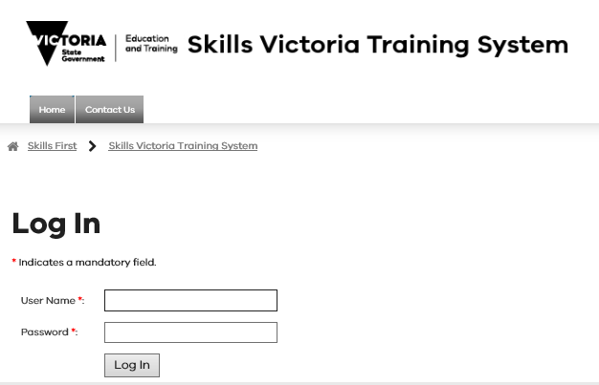
Reporting – PRE-ACCREDITED TRAINING DELIVERY (SVTS)
Note there are separate Reporting Guidelines for all 2021 ACFE Board funded training delivery, which will be on the DET website.
It is your responsibility to accurately report the delivery of pre-accredited training programs, in accordance with the agreed Delivery Plan.
Accurate reporting is essential to assist the ACFE Board in understanding and responding to community need for pre-accredited training delivery.

Slide 22
Reporting – PRE-ACCREDITED TRAINING DELIVERY (SVTS)
Course delivery data must be entered into SVTS using the
State funding source code: ‘ACE’ (i.e. Funding Source State Code for standard ACFE pre-accredited programs).
Providers must report their pre-accredited Student Contact Hour data quarterly at a minimum by the following dates: 30 March 2021, 31 July 2021, 30 September 2021 and 15 January 2022. More frequent reporting may be requested.
Providers can upload their pre-accredited data at any time. Students do not need to have fully completed a pre-accredited course before the data is reported.
For assistance please submit an SVTS enquiry, or if you have problems logging-in, please refer to the SVTS Login User Guide on the SVTS log in page.

Slide 23
PAYMENTS AND REPORTING SCHEDULE
The SCH subsidy rate will remain at $9.10 in 2021.
The Training Delivery Support Grant will again be a component of your agreement for Pre-accredited training delivery in 2021, and will be $5,500.
Fee Concessions - The ACFE Board will reimburse providers for a proportion of the revenue foregone by granting fee concessions to learners in Pre-accredited programs, based on reported data in SVTS.
Regional Loading– a 20 per cent loading on regional delivery will be paid in May 2021, based on reported data in SVTS.
2021 Payment & Reporting Schedule
No. | Payment Processing date | Payment percentage (%) | Cumulative payment percentage (%) | Requirement for release of payment
1 | January | 35% | 35% | Contract execution
2 | April | 25% | 60% | 25% enrolments reported by 30 March
3 | August | 20% | 85% | 55% enrolments reported by 31 July
4 | October | 20% | 100% | 75% enrolments reported by 30 September

Slide 24
LEARNER ENGAGEMENT
A-FRAME PROGRAM (LEAP)

Slide 25

LEARNER ENGAGEMENT A-FRAME PROGRAM (LEAP) - OVERVIEW
The primary purpose of LEAP is to improve engagement with learners who may find the duration of pre-accredited courses (20 hours or longer) a barrier to participation, and to provide flexible pathways for them.
LEAP is a distinct and separate program from pre-accredited training delivery, in its particular focus on engagement.
LEAP is a small, targeted initiative, to assist providers to engage the most hard-to-reach learners. The 2021 LEAP EoI will be competitive.

Slide 26
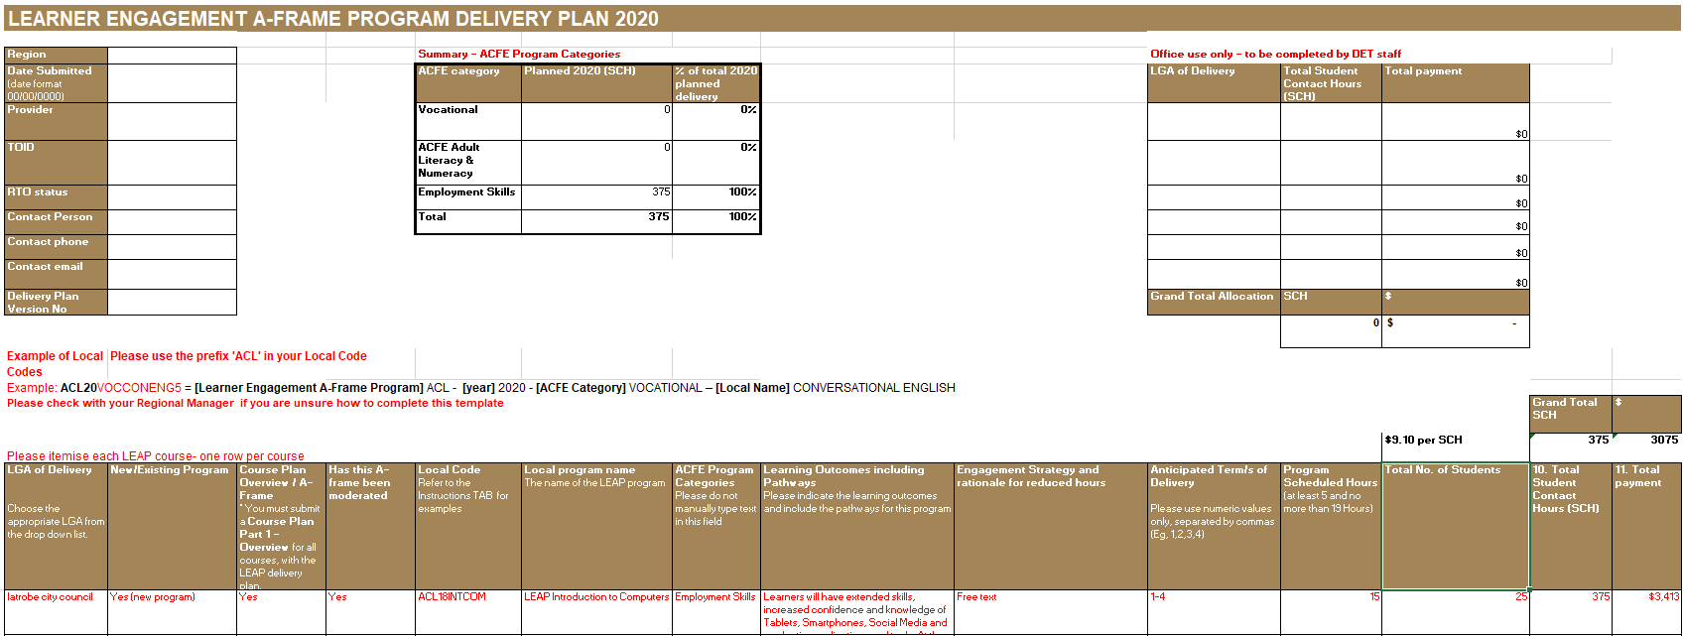
HOW TO APPLY FOR LEAP FUNDING
Submit your application in ONE email with your Pre-accredited Training application (and Skills for Work and Study if applicable) by COB 14 October 2020 via email to: training.participation@education.vic.gov.au
Only providers who have applied for a 2021 Pre-accredited allocation can apply for the Learner Engagement A-frame Program (LEAP).
Download and read the 2021 Learner Engagement A-frame Program Guidelines.
Consider if LEAP is appropriate for your 2021 delivery, and if your proposed LEAP delivery would meet the specific and distinct intent of LEAP.
LEAP courses are minimum of 5 hours and no more than 19 hours in duration. Where a course of 15 hours or longer is proposed, you need to indicate why the longer duration is required, and how it is distinct from a pre-accredited course.
Complete the 2021 LEAP Delivery Plan template by LGA and Course Plans. Session Plans are not required. The LEAP Delivery Plan also includes the new elements for 2021:
      Updated ACFE Program Categories
      Mode of delivery
      Delivery Site and Partnerships

Slide 27
LEAP ASSESSMENT CRITERIA
For LEAP, all Delivery Plans and Course Plans will be subject to the following assessment criteria:
Clear engagement strategy and rationale for LEAP course duration
LEAP programs are clearly distinguished from pre-accredited programs
Proposed courses which are 15 SCH or longer will be assessed as exceptions and will require a clear rationale for the course length, aligned to the LEAP Objectives
Programs aim to improve learning outcomes for learner categories in the guidelines.
Programs specify how learners will be linked to pathways to further education and training or employment.

Slide 28
Reporting – leap (SVTS)
Course delivery data must be entered into SVTS using the reporting codes as follows:
State funding source code: ‘ACE’ (i.e. Funding Source State Code for standard ACFE pre-accredited programs).
Course code: use prefix ‘ACL, followed by ‘21’, followed by your designated code (maximum 12 characters). E.g.: ‘ACL21RESUME’.
Course name: use prefix ‘LEAP’, followed by your designated name. E.g.: ‘LEAP Resume Preparation’.
Providers can upload their LEAP data at any time but must report their data quarterly at a minimum by the following dates: 30 March 2021, 31 July 2021, 30 September 2021 and 15 January 2022.
Students do not need to have fully completed a LEAP course before the data is reported.

Slide 29
NEXT STEPS AND FURTHER OPPORTUNITIES

Slide 30
FURTHER OPPORTUNITIES
Skills for Work and Study pilot programs
The Skills for Work and Study pilot programs are high quality, industry contextualised literacy and numeracy programs designed for learners with low literacy and numeracy skills and interested in one of the available industries. The programs have been developed by Learn Local providers to share with other Learn Local providers across Victoria.
Further information on the Skills for Work and Study pilot programs, and other upcoming opportunities, will be presented at an information session on Monday, 28 September. If you are interested, please register and attend the information session.
Details are available in the General Memo of 10 September 2020.

Slide 31
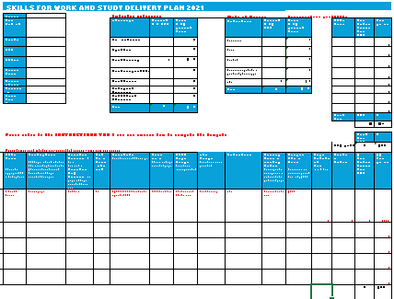
HOW TO APPLY FOR SKILLS FOR WORK AND STUDY FUNDING
Submit your application in ONE email with your Pre-accredited Training application (and LEAP if applicable) by COB 14 October 2020 via email to: training.participation@education.vic.gov.au
Only providers who have applied for a 2021 Pre-accredited allocation can apply for the Skills for Work and Study pilot programs.
Download and read the 2021 Skills for Work and Study Guidelines
Read the draft A-frames for the 7 industry-contextualised programs via the link in the Guidelines. Consider if Skills for Work and Study is appropriate for your 2021 delivery. You can apply for more than one of the 7 programs.
Additional delivery hours are available in 2021 to pilot the Skills for Work and Study programs.
Complete the EoI Application Form at Attachment 1 of the Skills for Work and Study guidelines.
Complete the 2021 Skills for Work and Study Delivery Plan template by LGA and list Skills for Work and Study programs in your order of priority. Please include the Course Code (field F) for each Skills for Work and Study program you are applying for.

Slide 32
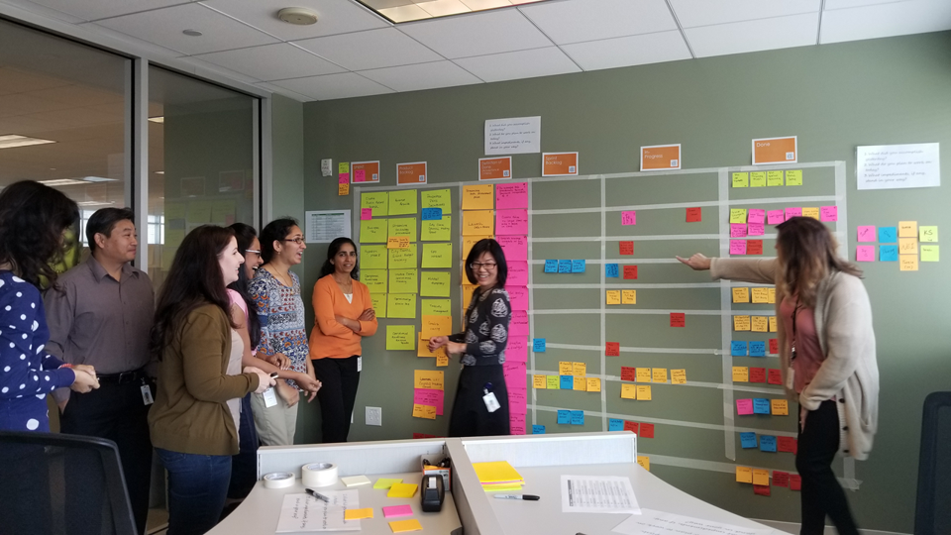
REGIONAL FORUMS
To help you in developing your Delivery Plans, a number of forums focussing on contracting workshops will be scheduled across regions following these information sessions.
Regional staff will be available at the forums to provide advice and support on how to complete your delivery plans.
Regional Forums will be held in September-October 2020.
These are not compulsory to attend.
Please contact your Regional Office for further information.

Slide 33
TIMELINES & NEXT STEPS
17 & 23 September 2020
28 September Skills for Work and Study
Participate in an Information Session and review the information on the DET website.
Mid-October 2020
Ensure you have a current BGS and financial statements uploaded in SAMS2 system. Extended to 27 November, but note providers without a valid BGS by then will not be offered a contract
Throughout September-October 2020
Attend a regional forum for assistance with contracting or to discuss partnership options with other Learn Locals in your region. Registration details will be emailed to providers.
14 September 2020
Read and action the Memo, to commence the 2020 Pre-accredited Training Delivery, LEAP and Skills for Work and Study EoI process.
14 September 2020
Download the 2021 Guidelines for the program you are applying for and the 2021 Delivery Plan Template from the DET website.
By 14 October 2020
Complete & submit your EoI in ONE email, including Delivery Plans for all programs you are applying for, and if applicable A-frames, to: training.participation@education.vic.gov.au.
By late-November 2020
Regional Office staff will review your delivery plan(s) and confirm delivery by LGA with you.
December 2020
A Service Plan will be loaded into SAMS2 for your authorised signatory to accept. Review and accept Service Plan.
January - February 2021
First Payment

Slide 34

NOTIFICATIONS OF OUTCOMES
Notifications and Outcomes
Providers will be formally notified via email regarding assessment of their Delivery Plan(s) and associated A-frames, and the approved funding outcome.
Service Plan(s) will be sent to your organisation’s signatory via SAMS2 once all steps have been completed for execution in December 2020.
Check and ensure that your organisation’s contact details and signatories are up to date in SAMS2.

Slide 35
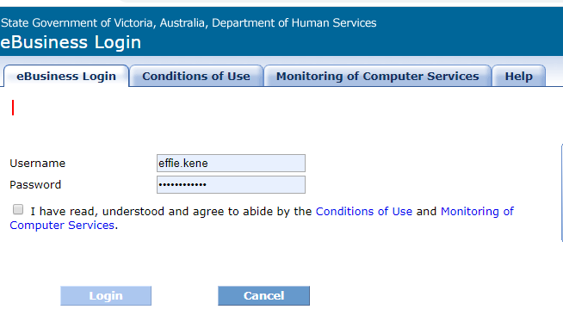
CONTRACTING & SUBCONTRACTING (SAMS2)
SAMS2 - SERVICE AGREEMENT
Providers are contracted via a Service Agreement
in SAMS2.
Service Plan
Service Plans are listed within the Service Agreement. Pre-accredited Training Delivery, LEAP and Skills for Work and Study will be listed as separate Service Plans.
SUBCONTRACTING
Providers wishing to enter into a subcontracting arrangement to deliver pre-accredited training, must inform the Department in writing and comply with the terms and conditions listed in Clause 10 Assignment and Subcontracting of the Service Agreement.

Slide 36
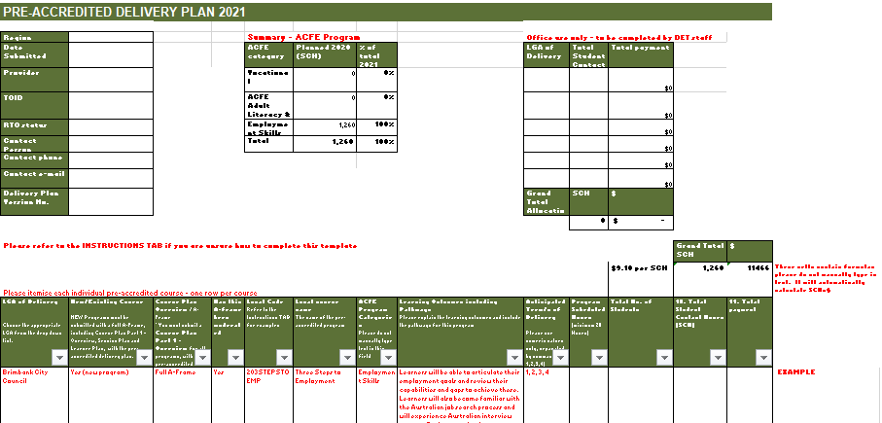
CONTRACT VARIATIONS
Variations to delivery Plans
Approval must be obtained for all variations to contracted Delivery Plans by the Department before making any changes and commencing delivery.
A variation to the Delivery Plan that includes changes to LGA targets or payments, can only be requested during a formal variation window. Advice on variation windows will be provided during the year.
Please ensure the Chairperson (or approved delegate) of your organisation approves any variation prior to submitting a request.

Slide 37
CHECK LIST
Important EoI details to check:
Current BGS and financial statements completed and uploaded in SAMS2.
Contact details and signatory up to date in the Delivery Plan and in SAMS2.
Ensure all Delivery Plans and (preferably) all A-frames for Pre-accredited Training and if applicable LEAP and/or Skills for Work and Study are submitted in ONE email to training.participation@education.vic.gov.au
Following EoI submission, ensure you receive an acknowledgement of the submission.
If you have not received a confirmation of your Delivery Plan(s) by late November, please contact your regional office.

Slide 38
THANK YOU –
ANY QUESTIONS?

