Slide 1
Business Approvals Journey Map
Council User Guide
The Business Approvals Journey Map template is part of the Business Friendly Councils (BFC) product suite. The Journey Map shows the common regulations that apply to a business and approximate approvals timeframes. Council staff can use this tool when engaging with businesses to help them consider which permits and registrations they may need to operate.
The BFC products and processes were developed collaboratively with councils and tested with businesses through pilot projects led by the Victorian Government Department of Jobs, Skills, Industry and Regions (DJSIR). Application of the BFC products and processes benefits both councils and their business customers by providing more consistent and timely regulatory permit advice, enabling better quality applications and improving communication between council regulatory areas involved in the business approvals process.
Note: The BFC products are designed for individual councils to adopt and customise according to their individual local government area requirements. Councils should determine any disclaimers and privacy statements that are necessary to be applied prior to publication. It is intended that once this product is ready for implementation within your Council this title page should be deleted or replaced with equivalent Council instructions.
Disclaimer: This resource has been developed for the Business Friendly Councils initiative. This resource may be of assistance to you but the State of Victoria and its employees do not guarantee that the resource is without flaw of any kind or is wholly appropriate for your particular purposes and therefore disclaims all liability for any error, loss or other consequence which may arise from you relying on any information in this resource. While every effort has been made to ensure the currency, accuracy or completeness of the content we endeavour to keep the content relevant and up to date and reserve the right to make changes as required. The Victorian Government and other authors do not accept any liability to any person for the information (or the use of the information) which is provided or referred to in the resource.
Business Approvals Journey Map - Generic - Nov 2025
Contact: RegulatoryReform@ecodev.vic.gov.au

Slide 2





Business Approvals Journey Map
Starting, expanding or buying a business?
[Council branding and disclaimer to be applied. Content customisation and authorisation should be obtained from the responsible Council department]
PERMIT TYPES
Depending on what your business is going to do, one or more of the following permits may be required. For Building and Health permits, you will need a current valid Planning permit first.
Planning
May be required to operate a home business, change the use of a property or land, add signage or other external building modifications, and to trade liquor.
Building
May be required when your building will be structurally altered or modified internally (including changes that may impact safety).
Environmental Health
Will be required for businesses involving the sale of food; hair, beauty, health and fitness services, tobacco, prescribed accommodation, and where wastewater and septic systems are used.
Local laws
May be required to approve animal businesses, mobile food trading, portable signage, goods for sale or display, outdoor dining, and consumption of liquor on Council land.
STEP 1.
PREPARE
STEP 2.
APPLY
Prepare and gather documents.
Develop your plan for your business.
Research how
and where you want to operate.
Connect with Council
by completing the business checklist.
Meet with council through a pre-application meeting.
Submit your application(s) and pay lodgement fees.
ASSESSMENT
STEP 3.
Your business
plans determine
which permits and registrations you need.
2-12 months
Planning
Timelines can depend on whether Council needs to:
Advertise your plans to the public
Request further information
Perform an on-site inspection
Await a VCAT decision
Refer to State Government regulators
1-2 months
Building
1-2 months
Environmental Health
2 weeks
Local Laws
STEP 4.
OUTCOME
STEP 5.
ONGOING SUPPORT
Council will keep a record of your permit and regulation outcomes.
With the right approvals in place, you can operate your business.
Join your local business community networks.
Stay in touch with Council for ongoing business support.
[Insert Council Disclaimer]
Questions? Reach out to our [Business Concierge function title] to understand the application process and to learn about approvals you need to operate your business.
Phone: Email:
Month Year

Slide 3
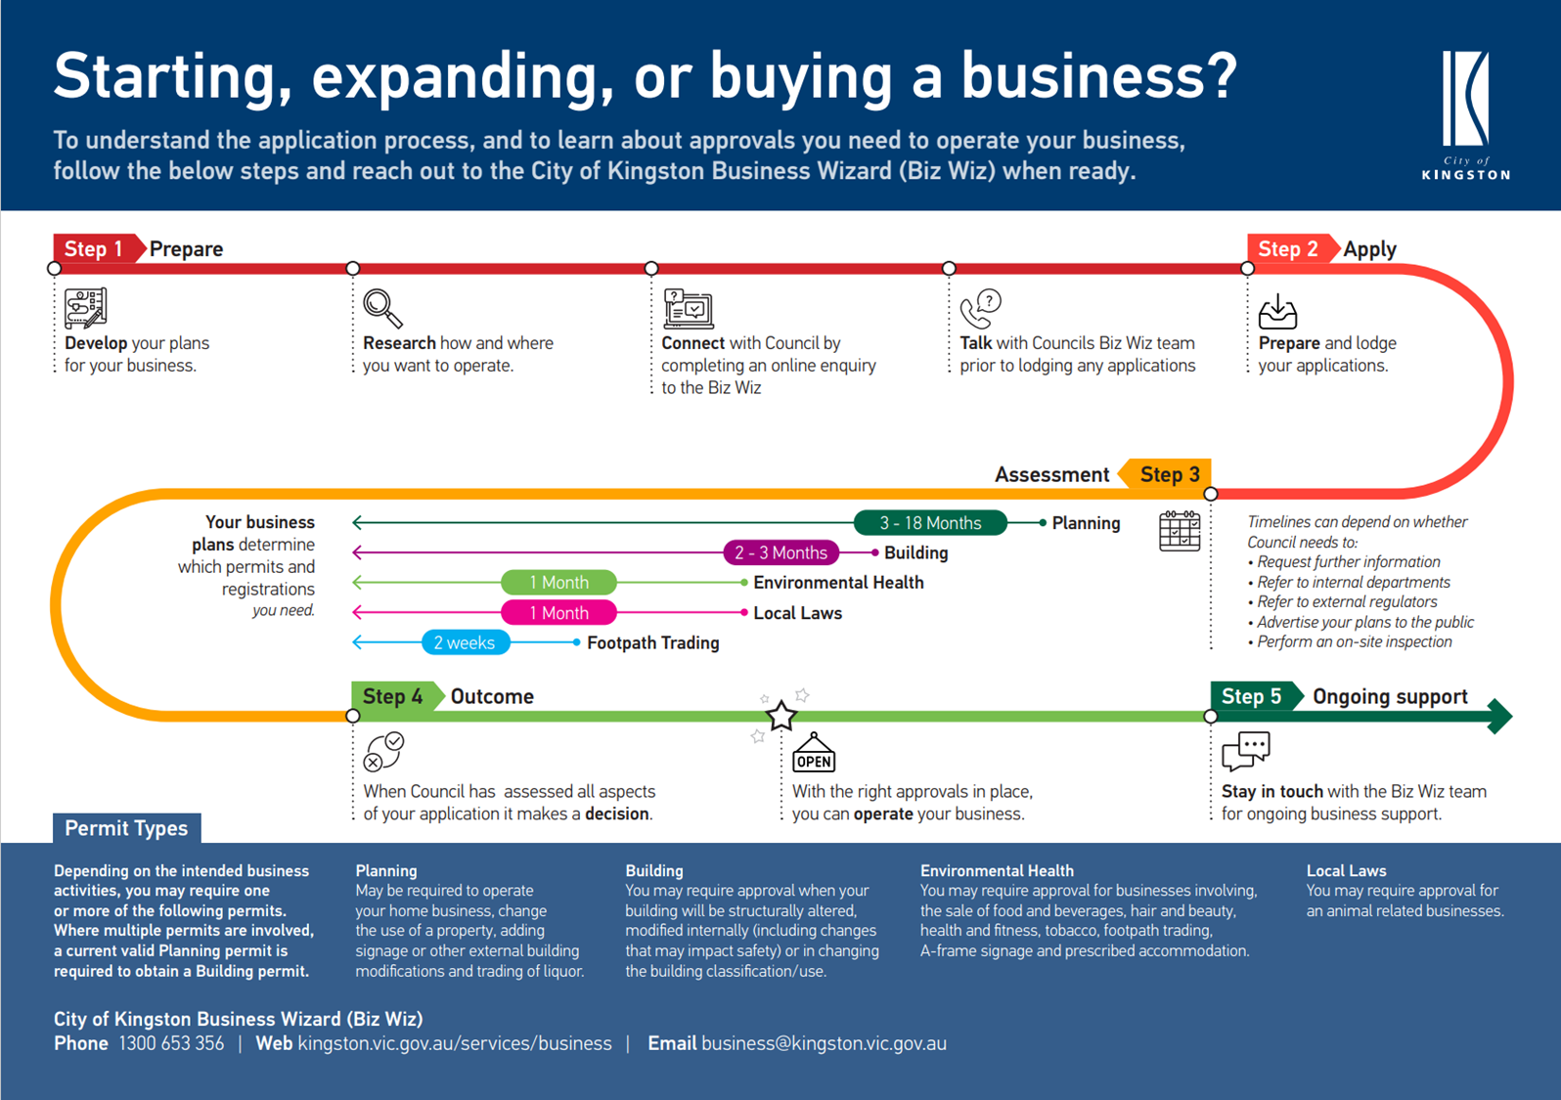
Example:
BFC Business Approvals Journey Map template customised by City of Kingston

Slide 4
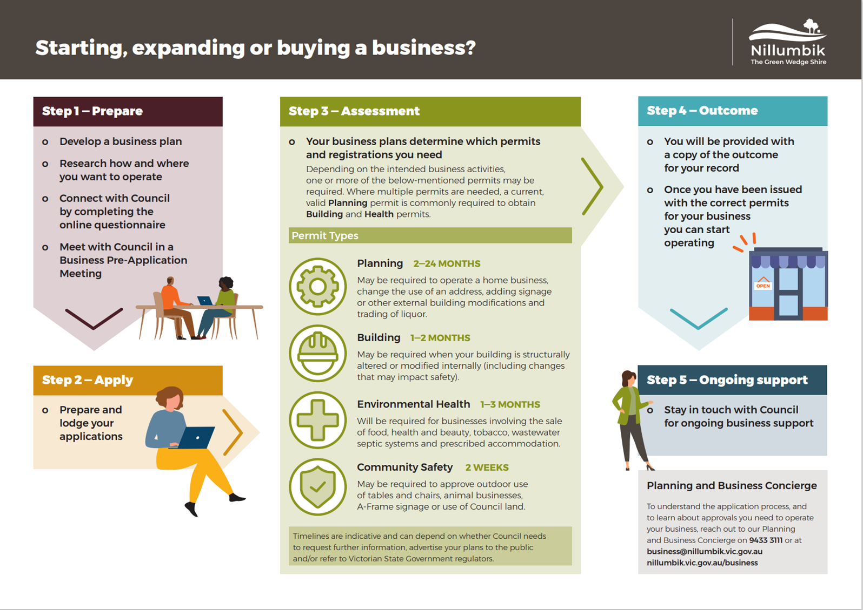
Example:
BFC Business Approvals Journey Map template customised by Nillumbik Shire Council

