Slide 1
Hospitality Business Approvals 2D Visual Council User Guide
The Hospitality Business Approvals 2D Visual template is part of the Business Friendly Councils (BFC) product suite. This template provides a visual guide of the common regulations that apply to a hospitality business. Council staff can use this tool when engaging with businesses to help them understand which permits and registrations they will need to operate.
The BFC products and processes were developed collaboratively with councils and tested with businesses through pilot projects led by the Victorian Government Department of Jobs, Skills, Industry and Regions (DJSIR). Application of the BFC products and processes benefits both councils and their business customers by providing more consistent and timely regulatory permit advice, enabling better quality applications and improving communication between council regulatory areas involved in the business approvals process.
Note: The BFC products are designed for individual councils to adopt and customise according to their individual local government area requirements. Councils should determine any disclaimers and privacy statements that are necessary to be applied prior to publication. It is suggested that once ready for implementation within your Council this title page should be deleted or replaced with equivalent Council instructions.
It is intended that once this product is ready for implementation within your Council this title page should be deleted or replaced with equivalent Council instructions.
Disclaimer: This resource has been developed for the Business Friendly Councils initiative. This resource may be of assistance to you but the State of Victoria and its employees do not guarantee that the resource is without flaw of any kind or is wholly appropriate for your particular purposes and therefore disclaims all liability for any error, loss or other consequence which may arise from you relying on any information in this resource. While every effort has been made to ensure the currency, accuracy or completeness of the content we endeavour to keep the content relevant and up to date and reserve the right to make changes as required. The Victorian Government and other authors do not accept any liability to any person for the information (or the use of the information) which is provided or referred to in the resource.
Hospitality Business Approvals 2D Visual template - Nov 2025
Contact: RegulationReform@ecodev.vic.gov.au

Slide 2


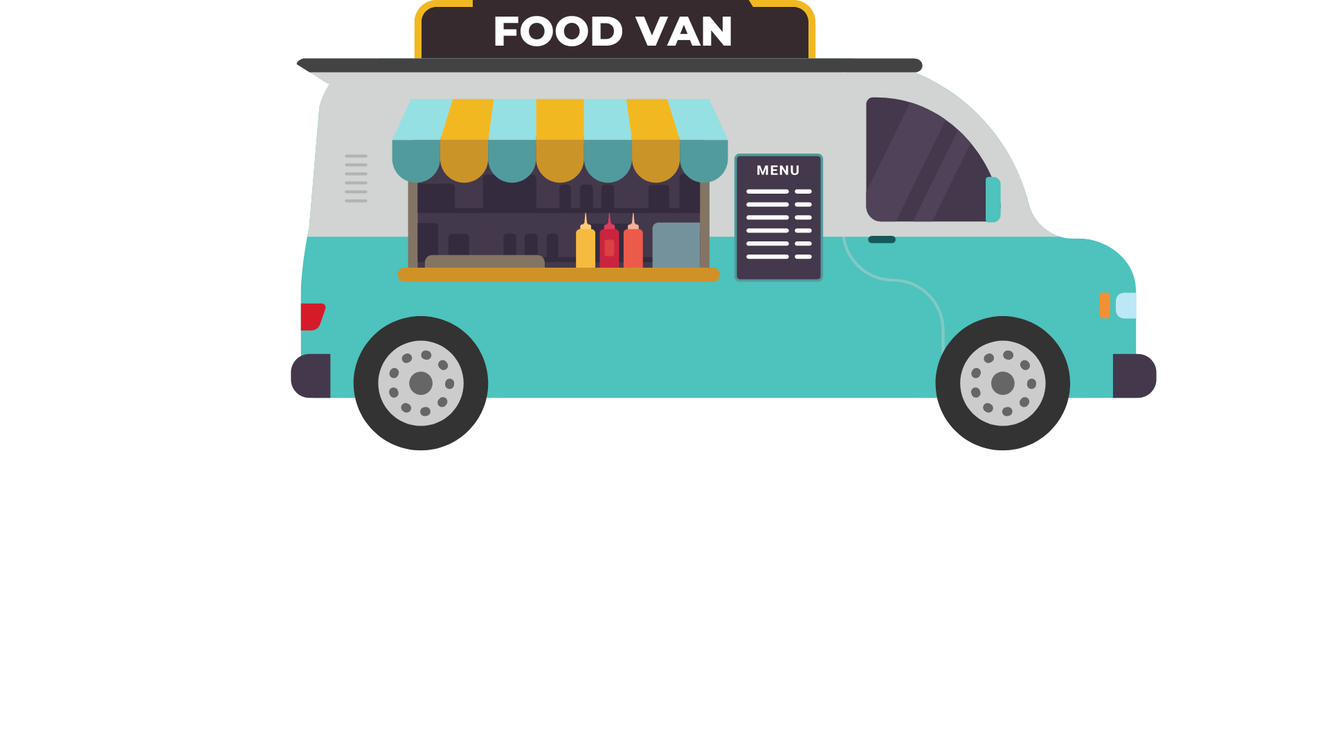





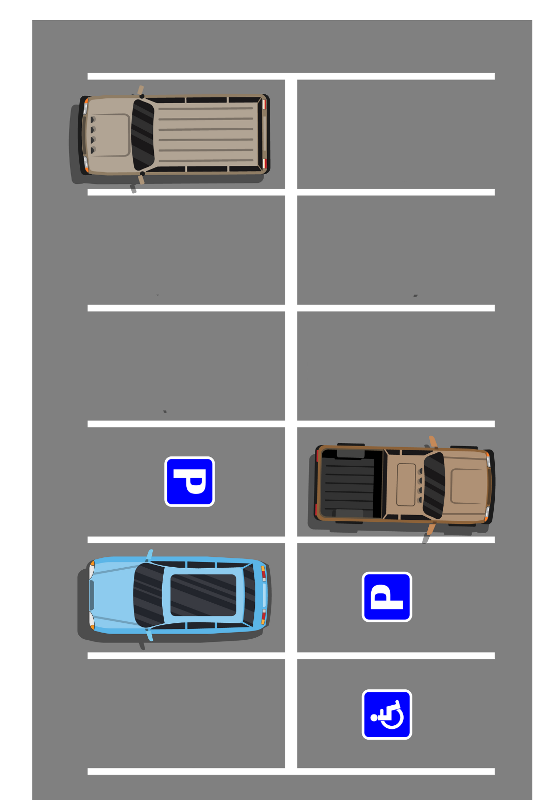





HOSPITALITY BUSINESS APPROVALS GUIDE
[Council branding and disclaimer to be applied. Content customisation and authorisation should be obtained from the responsible Council Department]
Waste & Recyclable Materials
Your business must have enough bins to accommodate all the rubbish and recyclable materials it produces.
A Waste Management Plan is required. You can elect to use the Council service (user pays service) where appropriate, or a private contractor. Contact your Council’s Waste Management Team for more information.
Mobile & Temporary Food Premises
If you want to sell food from a mobile premises (e.g. a food van or cart) or a temporary premises (e.g. a market stall), you need to register your vehicle or stall. For more information go to: Food trucks, vans and market stalls
You need to any consider on-site car parking requirements for your customers and staff and factor this into your building plans.
If want to change the number of car parking spaces required or provide some or all the required car parking spaces on another site, you will need to apply for a planning permit.
For more information to go: 52.06 CAR PARKING Victoria Planning Provisions Planning Scheme - Ordinance
Car Parking
In sewered areas you may need a food and oil interceptor (grease trap). Contact your local water authority for further information.
In unsewered areas, you will need an onsite wastewater system (septic system). If you need to install a new system or alter an existing system, you need a permit to install or alter a septic system.
Wastewater
Planning permits give permission to develop or use land in a certain way.
Reasons that you may require a planning permit include:
Change of Use – when you want to operate a business that uses the land for a different reason to its current or previous use (e.g. operate a shop in what was previously a warehouse).
Where you want to change a building or excavate land.
Advertising signs
Change to car parking
If you need a planning permit it must be issued from Council before you can obtain a building permit.
Planning Permits
If there is any risk of your business impacting your surroundings with noise, you should seek advice from an acoustics consultant as you may need an acoustic report.
Noise
If you want to sell food, you need to register your business with Council or the regulator (e.g. in some instances PrimeSafe or Dairy Food Safety Victoria). You will need to decide whether the business is a proposed restaurant/café, take away food premises or other, and discuss your proposal with Council. For further information visit: Starting a food business
Food businesses are classified based on food safety risk. Each class of food business has different operational requirements. For further information visit: Food business classification (health.vic.gov.au)
Food Act Registration
Any proposed building works must have a building permit before starting construction unless exempt. Building permits can also cover requirements relating to:
Fire safety
Amenities e.g. toilets
Accessibility e.g. wheelchair access
Liquor Licence
Outdoor Dining
Building Permits
If you want to sell alcohol, you need a liquor licence from Liquor Control Victoria: Do you need a liquor licence? | vic.gov.au
If you want to place tables and chairs on a footpath, you need a footpath trading permit from Council.
If you want to place a stand-alone sign e.g. A-frame sign on a footpath you need a footpath trading permit from Council.
A-frame Signage
[insert Council Disclaimer]
Hospitality Business Approvals Guide 2D Visual – Nov 2025
Notes:
Image Source: Concept Draw

