Slide 1
How to use the Grants Gateway –
Premier’s Spirit of Anzac Prize
The Grants Gateway is an online platform used by people applying to programs run by the Department of Families, Fairness and Housing.
You can access the Grants Gateway at https://grantsgateway.dffh.vic.gov.au/
We recommend using Chrome or Microsoft Edge as your browser while accessing the Gateway
This guide tells you:
How to set up a new account (pages 2 – 5)
How to log in (page 6)
How to create new applications, save and access drafts (pages 7 – 8)
How to reset your password (pages 9 – 11)

Slide 2
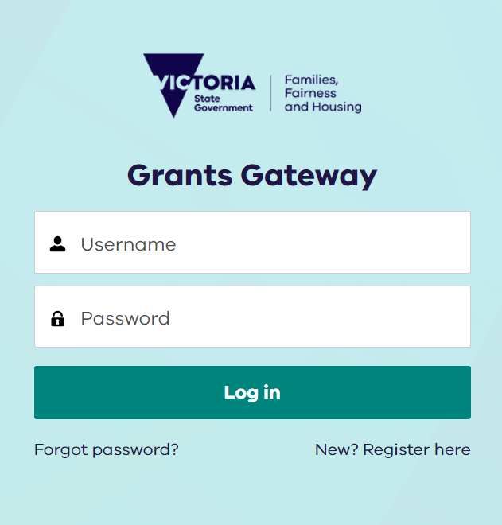
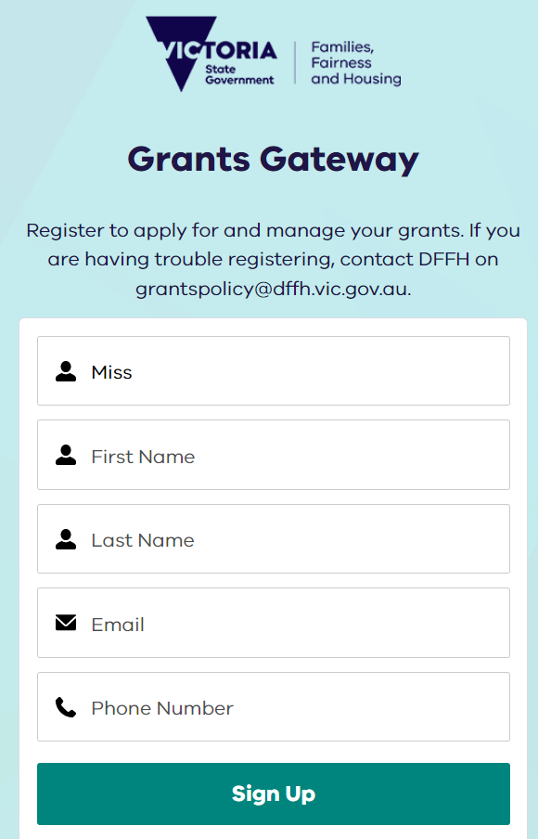
How to set up a new account steps 1-7
Step 1
Click “New? Register here”
Step 2
Enter title (e.g. Ms or Mr)
Step 3
Enter first name
Step 4
Enter last name
Step 5
Enter email address
Note: This will be your username
Step 6
Enter phone number
Step 7
Click “Sign Up”

Slide 3
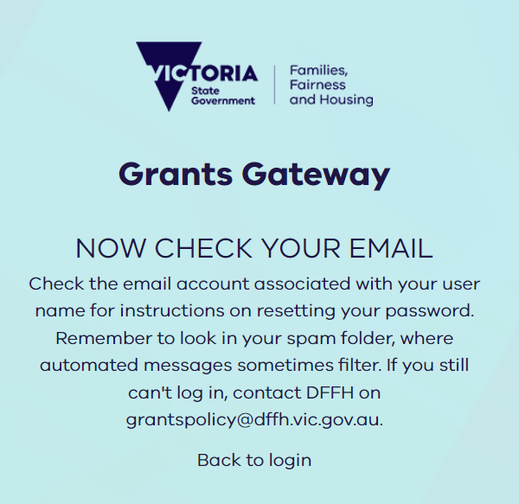
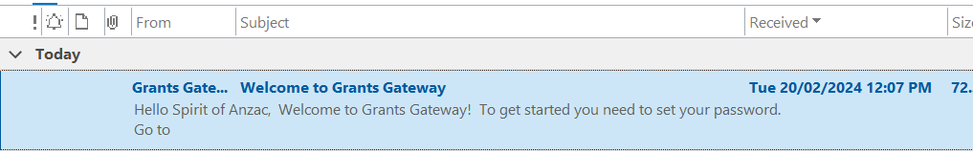
How to set up a new account steps 8 and 9
Step 8
Check for the confirmation screen
Step 9
Open your email inbox and look for the “Welcome to Grants Gateway” email.

Slide 4
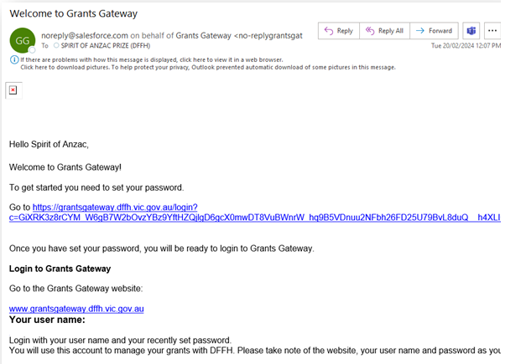
How to set up a new account step 10
Step 10
Click on the link to confirm and register your account

Slide 5
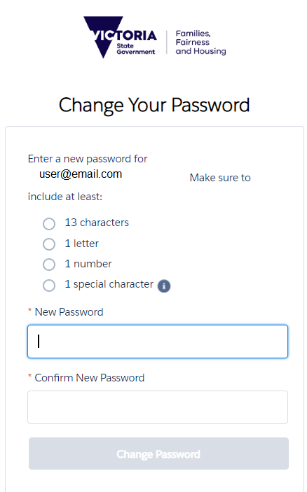
How to set up a new account steps 11-14
Step 11
After clicking on the email link, you will be asked to create a password
Passwords need to contain:
13 characters (minimum) including:
  1 letter
  1 number
  1 special character
Step 12
Confirm your password.
Step 13
Click “Change Password”.
Step 14
You now have access to the Grants Gateway.

Slide 6
How to log in
Step 1
Type your username (email address) and password here and click “Log in”

Slide 7
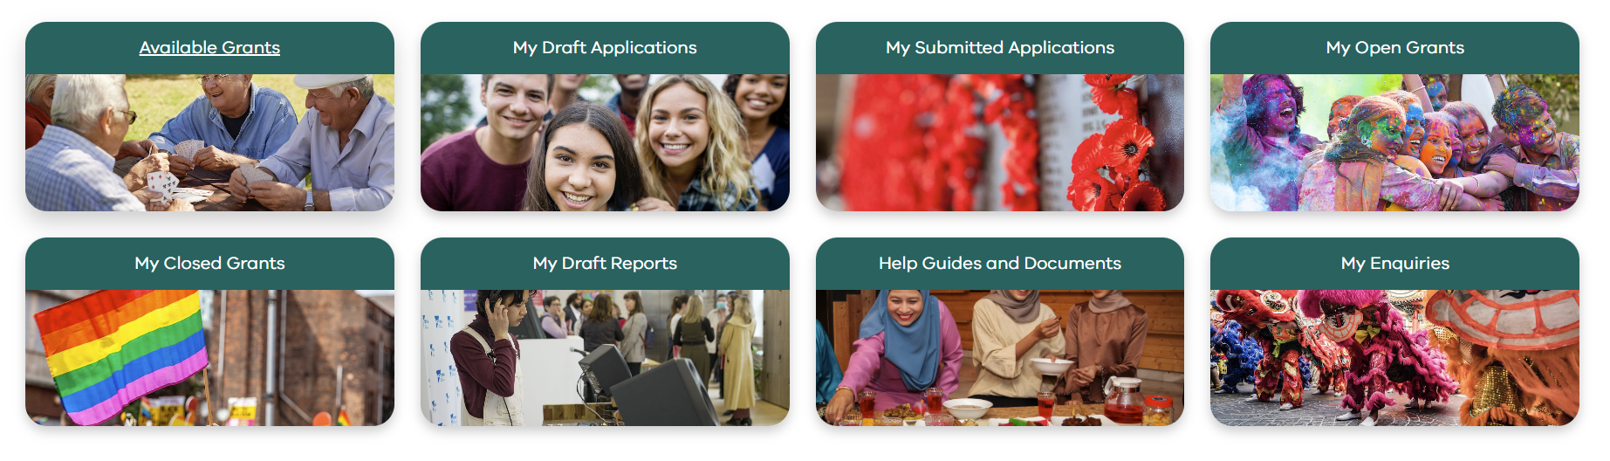

How to create a new application
My Draft Applications
Click here to access and submit your saved draft application(s).
My Submitted Applications
View your submitted application here, including attachments.
Available Grants
Click here start a new application
Step 1
Click here to see a list of programs currently open
Step 2
On the next page, click “Apply” next to the “Premier’s Spirit of Anzac Prize”
Help Guides and Documents
Resources to help you navigate the Grants Gateway.
My Enquires
You can contact us and view your enquiry and our response here. You can also email us at soap@dffh.vic.gov.au

Slide 8
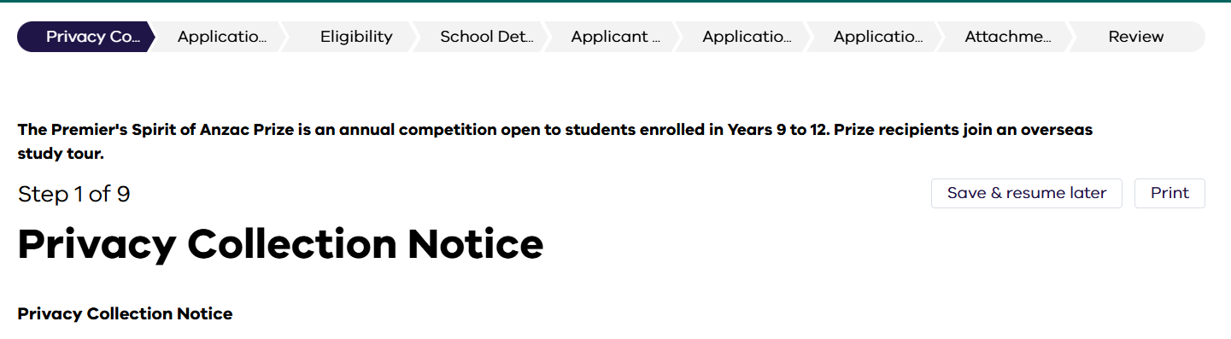
How to create save an application and access drafts
Saving your application
You can save you application at any time by clicking the “Save & resume later” button on the top right of any screen.
It is important to note:
The system will log you out after 15 minutes of inactivity.
You must either click the “save & resume later” or complete all the fields on the page and click “next” to save your progress.
If you click the “save & resume later” option, you will get a confirmation email.
Make sure you save your progress after entering any important information or making big changes.
Avoid starting new or multiple applications.

Slide 9
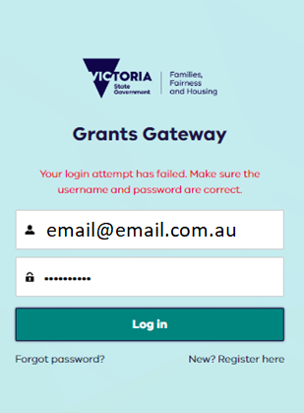
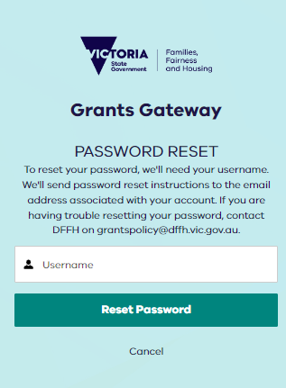
How to reset your password steps 1 and 2
Step 1
If you have forgotten your password
click “Forgot Password”
Step 2
Enter your username (email address) and
click “Reset Password”

Slide 10
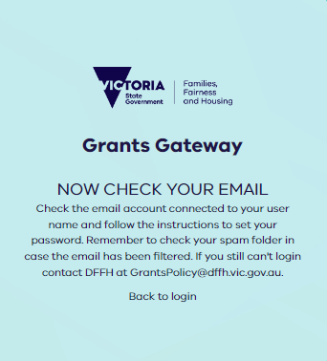
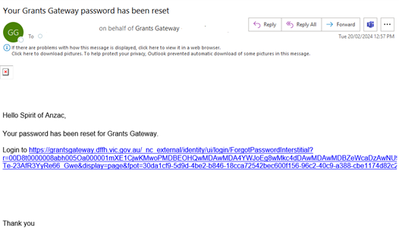
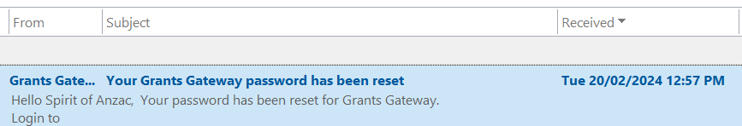
How to reset your password steps 3 and 4
Step 3
Check your email inbox and open the grants gateway email.
Step 4
Click on the link to reset your password

Slide 11
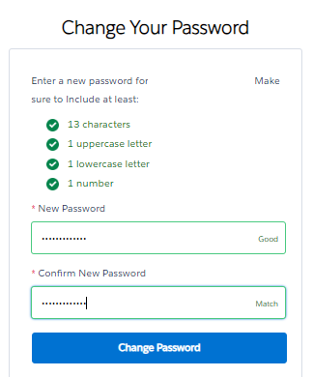
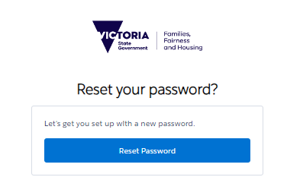
How to reset your password steps 5-8
Step 5
Click “Reset Password”
Step 6
After clicking on the email link, you will be asked to create a new password.
Passwords need to contain:
13 characters (minimum) including:
  1 letter
  1 number
  1 special character
Step 7
Confirm your password by repeating it.
Step 8
Click “Change password”.

